Slide 1
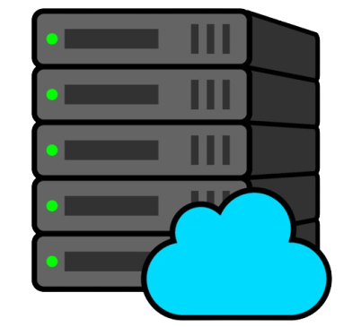


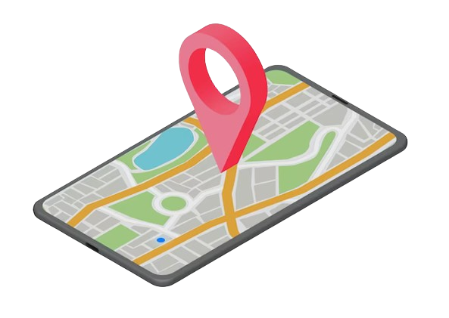
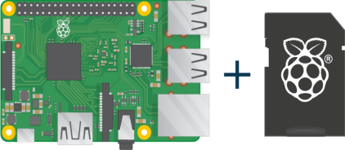


Server
GPS
Internet
Raspberry Pi
Cell Phone
Vehicle
User

Slide 2
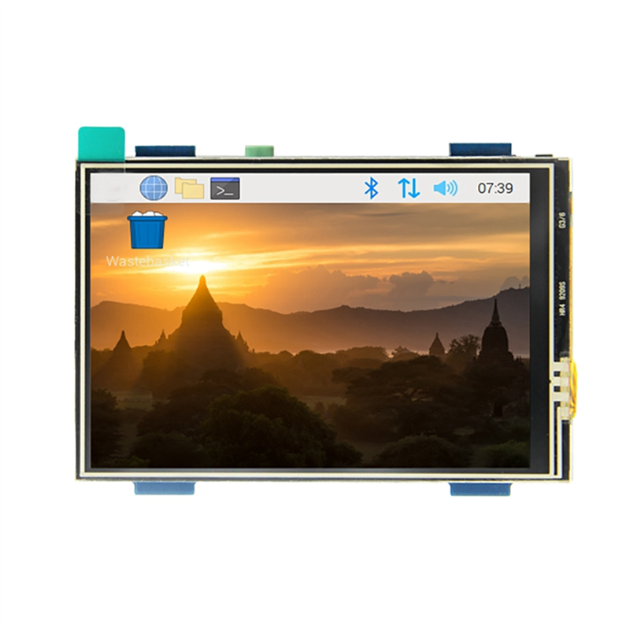
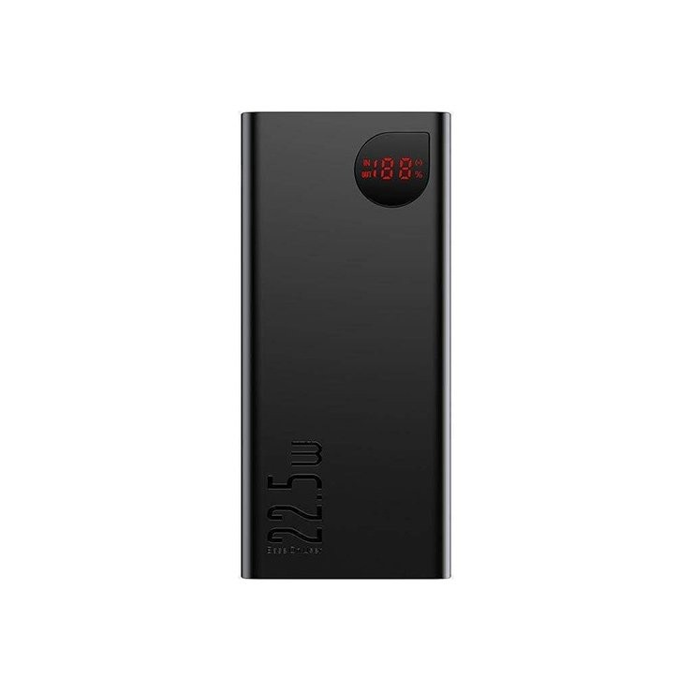
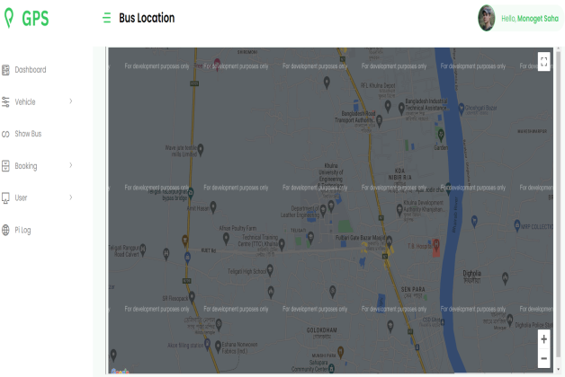
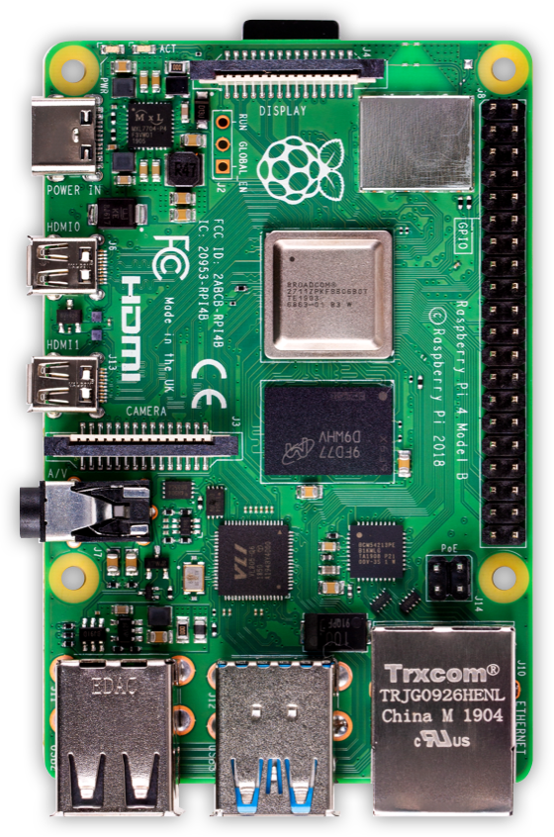
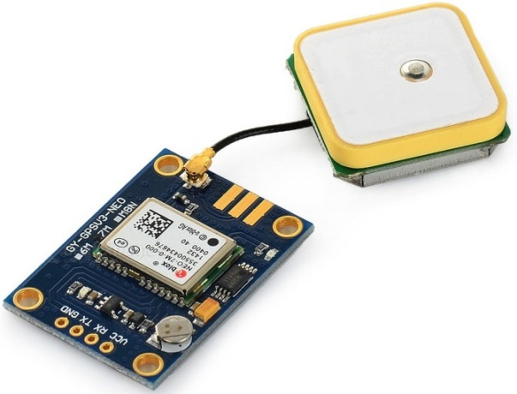

Raspberry Pi
GPIO Display
Power Bank
NEO-6M GPS Module

Slide 3
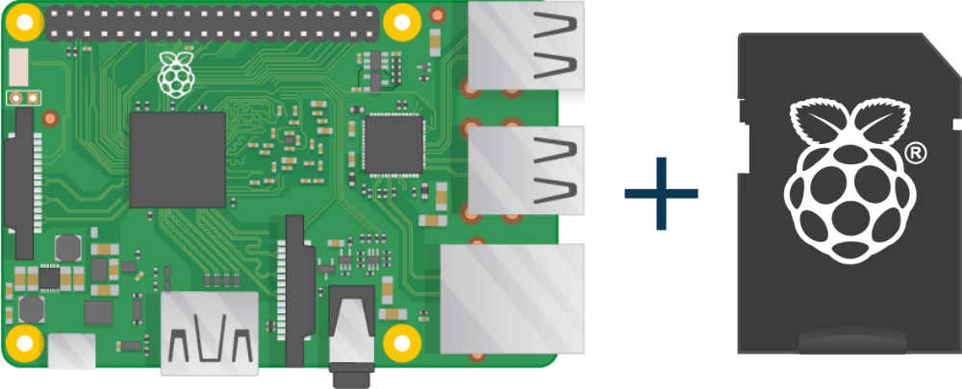

Slide 4
Start
Raspberry Pi Setup
Initialize GPS Module
Initialize Internet Connection
no
Try to Connect to Server
yes
Send Data to Server
End

Slide 5
Start
Server Setup
Database Design and Connect
Retrieve Vehicle Data
Retrieve Vehicle Data
Generate Dynamic Map Marker
End

Slide 6
